Slide 1
Constitution of India S4 KTU COMMON TO ALL BRANCHES

Slide 2
Syllabus
Module – 1 > Constitution of India
Module – 2 > DPSP, Fund. Rights & Duties
Module – 3 > Union Govt
Module – 4 > State Govt
Module – 5 > Federal System
Other Facts
It is mandatory non – credit paper ( MNC)
150 Marks paper – 100 ESE exam and 50 Marks Internal assessment

Slide 3
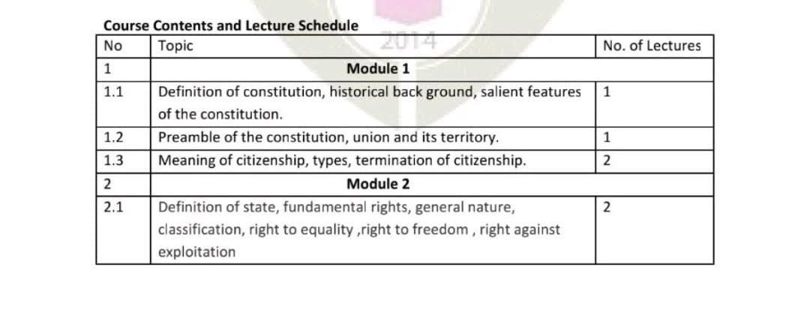

Slide 4
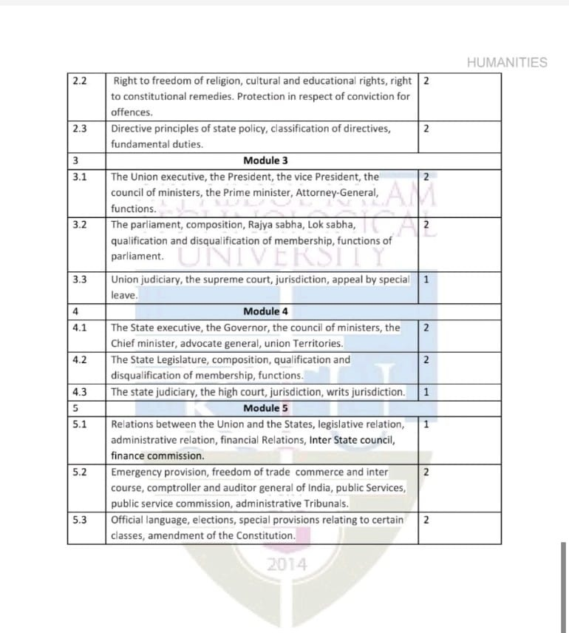

Slide 5
Module – 1 Constitution of India
Definition of Constitution
A constitution is the basic design of the structure and powers of the government and the rights and duties if its citizens.
There can be no nation without a constitution.
Constitution need not to be written in nature
Based on amendment nature, constitution has divided into 2 > Rigid and Flexible constitution.

Slide 6
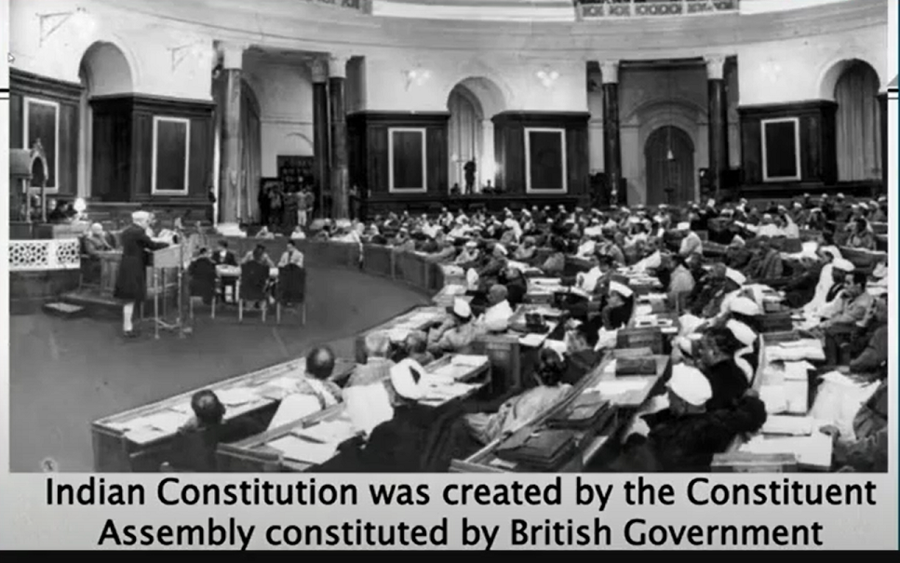

Slide 7
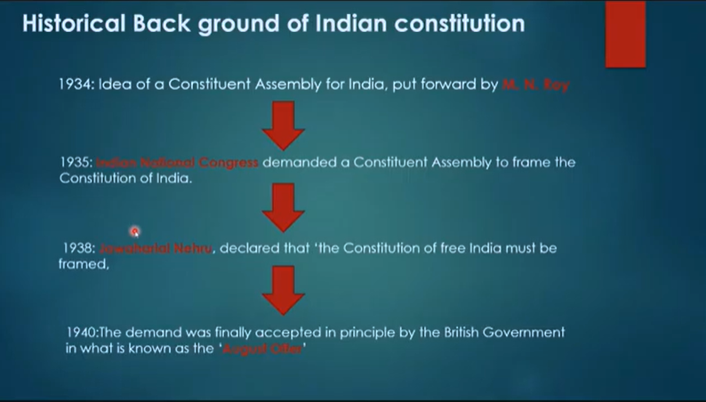

Slide 9
Historical Background of Indian Constitution
As early as in Dec 1918, in the 33rd session of the Indian National Congress held in Delhi, a resolution was unanimously adopted demanding for free will and right for India.
In 1928, Jawaharlal Nehru presented a draft for the constitution of India.
It was in 1934 that the idea of a Constituent Assembly for India was put forward for the first time by M.N. Roy, a pioneer of communist movement in India.
In 1942, Sir Stafford Cripps, a Member of the Cabinet, came to India with a draft proposal of the British Government on the framing of an independent Constitution to be adopted after the World War II.

Slide 10
The Cripps Proposals were rejected by the Muslim League, which wanted India to be divided into two autonomous states with two separate Constituent Assemblies.
9th Dec 1946, The constituent assembly meeting held to frame constitution under the temporary chairmanship of Dr. Sachidananad Sinha.
Later, Dr. Rajendra Prasad elected as the permanent chairman of constituent assembly.

Slide 11
After 15th AUG 1947, the constituent assembly became independent to take decisions as India got independence from British rule.
Dr. B.R. Ambedkar was appointed as the chairman of the Drafting committee which submitted their draft report to constituent assembly on 1948.
On 26th Nov, 1949 , the constitution of India was adopted and was signed by Dr.Rajendra Prasad – Chairman of constituent assembly.

Slide 12
In 1950, final session of constituent assembly unanimously elected Dr. Rajendra Prasad as the first president of Independent India after which constitution of India became operational.
1. The constituent assembly ratified the India’s membership of the Commonwealth in May 1949.
2. It adopted the national flag on July 22, 1947.
3. It adopted the national anthem on January 24, 1950.
4. It adopted the national song on January 24, 1950.
5. It elected Dr. Rajendra Prasad as the first President of India on January 24, 1950.
In brief, it took constituent assembly 2 years, 11 months and 17 days to finalize the constitution of India.
Originally (1949), the Constitution contained a Preamble, 395 Articles (divided into 22 Parts) and 8 Schedules

Slide 13
Salient Features of Indian Constitution
Lengthiest Written Constitution
Lengthiest of all the written Constitutions of the world
Presently (2019), it consists of a Preamble, about 470 Articles (divided into 25 Parts) and 12 Schedules
Written, like the American Constitution.
2. Sovereign, Democratic, Secular, Socialist & Republic
3. Parliamentary form of government
The parliamentary system is based on the principle of co-operation and co-ordination between the legislative and executive organs (British Parliamentary System of Government)

Slide 14
4. Combination of Flexibility and Rigidity
(Art 368) deals with amendment provision
5. Single Citizenship
In India, all citizens irrespective of the state in which they are born or reside enjoy the same political and civil rights of citizenship
Bi – Cameral Union government
Upper House and Lower House
7. Independent Federal Judiciary
Integrated as well as independent judicial system
The Supreme Court stands at the top of the integrated judicial system in the country

Slide 15
8. Fundamental Rights and Duties
Part III of the Indian Constitution guarantees six fundamental rights to all the citizens
The Part IV-A of the Constitution specifies the eleven Fundamental Duties
Directive Principles of State Policy (DPSP)
The Directive Principles are meant for promoting the idea of social and economic democracy (Welfare state)
10. Single Election Commission
11. State Languages
Emergency Provisions
Emergency provisions to enable the President to meet any extraordinary situation effectively. ( Art 352. 356. 360)

Slide 16
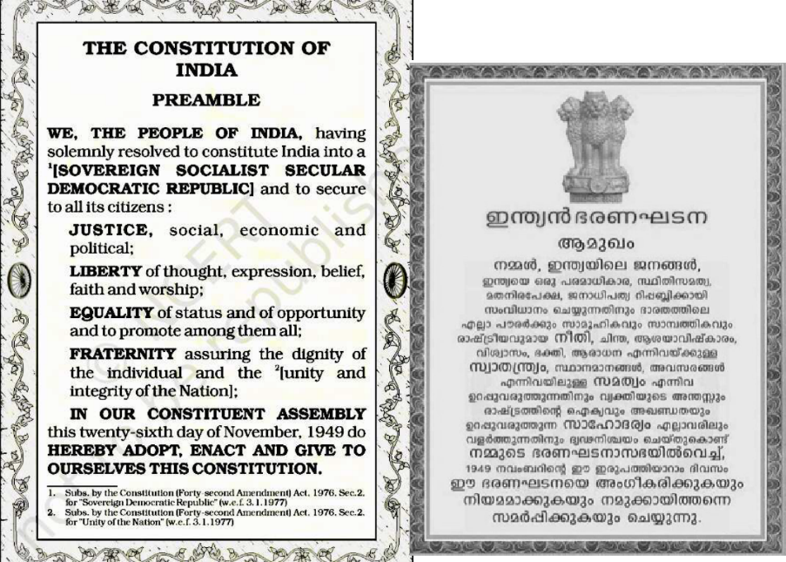

15

Slide 17
Preamble of the Constitution
The constitution of India begins with a preamble which specifies the nature of the Indian state.
Preamble is an introduction or preface to the constitution
Acc to N.A. Palkhivala – “Preamble is an identity card of the constitution”
Every constitution begins with a preamble
It is the soul and key of every constitution
Preamble defines the basic structure of constitution
Preamble was adopted by constituent assembly on 26th Nov 1949. (Later amendments made)

Slide 18
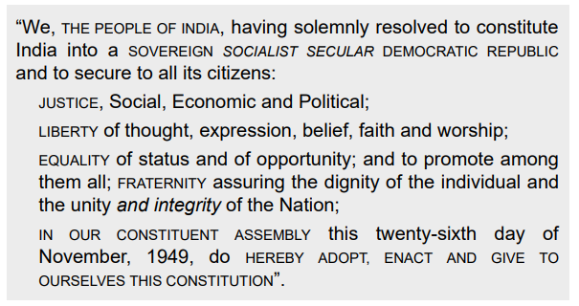
Preamble of the Constitution

Slide 19
Summary of the Preamble
Source of authority of the Constitution: The Preamble states that the Constitution derives its authority from the people of India.
Nature of Indian State: It declares India to be of a sovereign, socialist, secular, democratic and republican polity.
Objectives of the Constitution: It specifies justice, liberty, equality and fraternity as the objectives.
Date of adoption of the Constitution: It stipulates November 26, 1949, as the date.

Slide 20
Sovereign: The word ‘sovereign’ implies that India is neither a dependency nor a dominion of any other nation, but an independent state
Socialist: The Indian brand of socialism is a ‘democratic socialism’ and not a ‘communistic socialism’ ( Mixed Economy)
Democratic: The term ‘democratic’ is used in the Preamble in the broader sense embracing not only political democracy but also social and economic democracy.

Slide 21
Republic: Therefore, the term ‘republic’ in our Preamble indicates that India has an elected head called the president. He is elected indirectly for a fixed period of five years.
Justice: The term ‘justice’ in the Preamble embraces three distinct forms– social, economic and political
Liberty: The term ‘liberty’ means the absence of restraints on the activities of individuals, and at the same time, providing opportunities for the development of individual personalities.

Slide 22
Equality: The term ‘equality’ means the absence of special privileges to any section of the society, and the provision of adequate opportunities for all individuals without any discrimination.
Fraternity: Fraternity means a sense of brotherhood. The Constitution promotes this feeling of fraternity by the system of single citizenship.

Slide 23
Union and its Territory
Articles 1 to 4 under Part-I of the Constitution deal with the Union and its territory.
Article 1 describes India, that is, Bharat as a ‘Union of States’
The Constituent Assembly had to adopt a mix of both (‘India, that is, Bharat’)
The country is an integral whole and divided into different states only for the convenience of administration
Notes:
The Aryans arrived in the Harappan civilization around 2000 BC. He used to come from the western dry region. Seeing the vast water source of the Indus and the surrounding river, Aryans called it ‘Sindhu’. The civilization around the Indus River came to be known as the ‘Sindhu Civilization’. People living in Sindh got fame in the whole world under the name ‘Sindhu‘ and the area known as ‘Sindhustan‘. Trade of the Sindhu civilization often happens with Mesopotamian and Roman civilization people, In the language of Persia and Roman, the pronunciation of Sindhu is different.
That’s why Sindhu and Sindhustan pronounce Hindu and Hindustan respectively.
In the Mesopotamian language, only the vowel was used instead of the consonant, which led to the ‘Indu’ of Hindu and ‘Industaan’ of Hindustan.
The name of the country Bharat has been written in the literature of all languages since ancient times. For thousands of years, a large part of the society has been addressing the name Bharat,

Slide 24
According to Article 1, the territory of India can be classified into three categories:
1. Territories of the states
2. Union territories
3. Territories that may be acquired by the Government of India at any time.
At present, there are 28 states and 9 union territories. The states are the members of the federal system and share a distribution of powers with the Centre.

Slide 25
Article 2 grants two powers to the Parliament: (a) the power to admit into the Union of India new states; and (b) the power to establish new states.
Article 3, on the other hand, relates to the formation of or changes in the existing states of the Union of India. In other words, Article 3 deals with the internal re-adjustment of the territories of the constituent states of the Union of India
Article 3 authorizes the Parliament to: (a) form a new state by separation of territory from any state or by uniting two or more states or parts of states or by uniting any territory to a part of any state; (b) increase the area of any state; (c) diminish the area of any state; (d) alter the boundaries of any state; and (e) alter the name of any state

Slide 26
Moreover, the Constitution (Article 4) itself declares that laws made for admission or establishment of new states and formation of new states and alteration of areas, boundaries or names of existing states are not to be considered as amendments of the Constitution under Article 368. This means that such laws can be passed by a simple majority and by the ordinary legislative process.

Slide 27
Citizenship
Citizenship is the status of a person recognized under the law of a country of belonging to thereof.
Citizens are full members of the Indian State who enjoys all civil and political rights.
The Constitution deals with the citizenship from Articles 5 to 11 under Part II
Single citizenship: The citizens in India owe allegiance only to the Union. There is no separate state citizenship

Slide 28
According to the Constitution, the following four categories of persons became the citizens of India at its commencement i.e., on January 26, 1950:
(a) Persons domiciled in India
(b) Persons migrated from Pakistan
(c) Persons migrated to Pakistan but later returned
(d) Persons of Indian origin residing outside India.

Slide 29
CITIZENSHIP ACT, 1955
The Citizenship Act (1955) provides for acquisition and loss of citizenship after the commencement of the Constitution.
Acquisition of Citizenship ( Types )
Birth
Citizenship by birth
2. Descent : A person born outside India
A person born outside India shall not be a citizen of India by descent, unless his birth is registered at an Indian consulate within one year of the date of birth or with the permission of the Central Government, after the expiry of the said period

Slide 30
3. Registration
The Central Government may, on an application, register as a citizen of India any person
4. Naturalisation
The Central Government may, on an application, grant a certificate of naturalisation to any person
5. Incorporation of territory
If any foreign territory becomes a part of India, the Government of India specifies the persons who among the people of the territory shall be the citizens of India.

Slide 31
3. By Deprivation
It is a compulsory termination of Indian citizenship by the Central government, if:
(a) The citizen has obtained the citizenship by fraud:
(b) The citizen has shown disloyalty to the Constitution of India:
(c) The citizen has unlawfully traded or communicated with the enemy during a war;
(d) The citizen has, within five years after registration or naturalization, been imprisoned in any country for two years; and
(e) The citizen has been ordinarily resident out of India for seven years continuously

Slide 32
Loss of Citizenship
1. By Renunciation
Any citizen of India of full age and capacity can make a declaration renouncing his Indian citizenship
2. By Termination
When an Indian citizen voluntarily acquires the citizenship of another country, his Indian citizenship automatically terminates.

